Slide 1

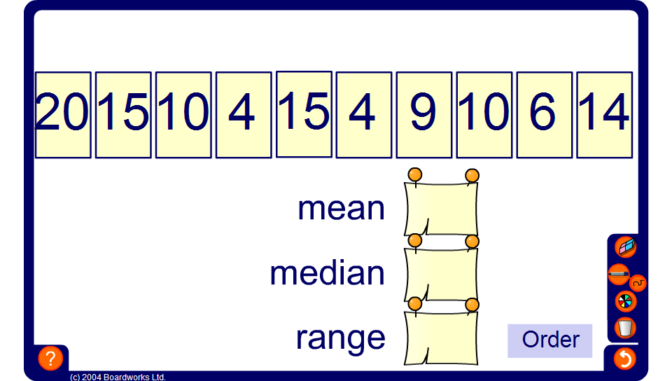


Find the mean, median and range
Notes:
Use the activity to practise finding the mean, median and range.
If there is a modal value for a particular data set, ask pupils to tell you what this is.

